Slide 1
Universal Response Engine: LLMs for Good
Team #35
Client: Ahmed Nazar
Advisor: Mohamed Selim

Slide 2
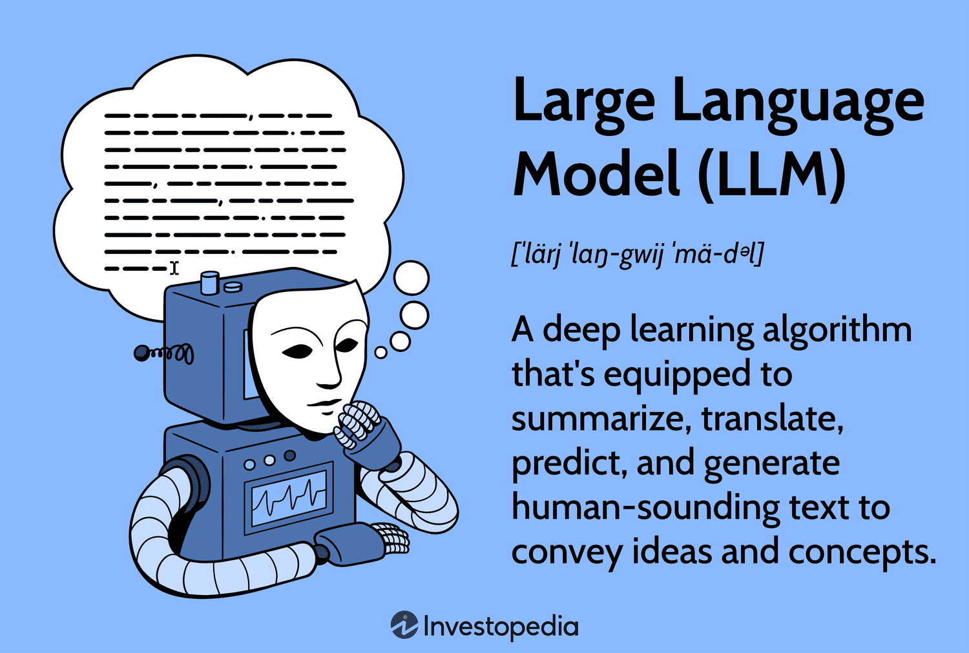
Notes:
What is an LLM?
Go back a few steps…
AI: broad term, intelligent machines
ML: subfield of AI, pattern recognition, predicting data
LLMs: subfield of ML, taking pattern recognition and a combination of other ideas to start generating text, like natural languages, and other data
How do LLMs work?
Combine lots of datasets
Feed data to a neural network that processes it with calculations (like calculating similarity between words)
Finetune it by training it on specific datasets

Slide 3
Project Overview
Creating an LLM for humanitarian use
Chatbot-like website where users provide questions/prompts
Model responds with relevant links, media, info (multimodal)
Notes:
Our project aims to address a critical gap in accessible and comprehensible support for individuals facing challenges. Many people experience difficult circumstances and may feel isolated when seeking help. Although there are a lot of good resources available, they are often fragmented and require these distraught people to sift through multiple pages of information from different sources.
What makes it different: societal good, open-source, no data tracking, to help people in vulnerable situations
Fine-tuned, trained, vetted on empathetic datasets that provide medical advice, emergency advice, etc.

Slide 4
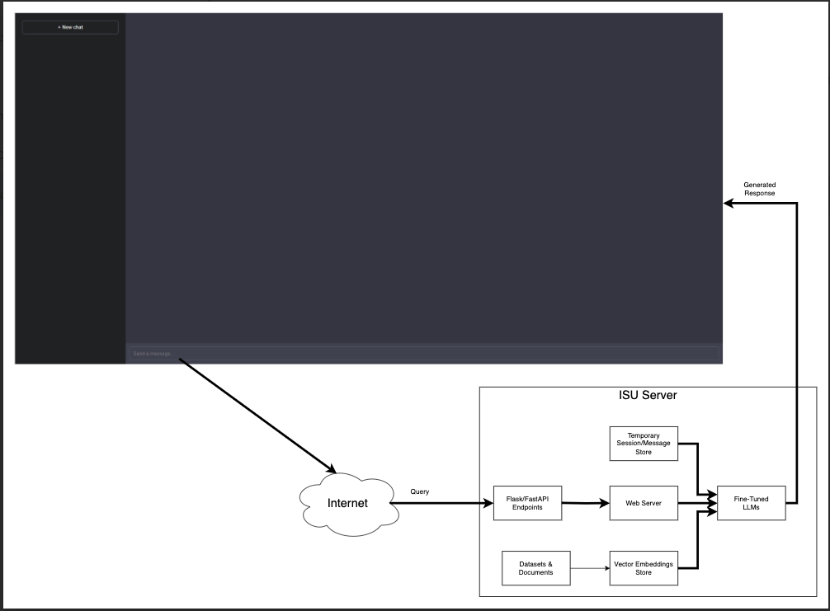
Detailed Design and Visuals
Our project will have a front end that is similar to a lot of chatbots. We are aiming for a simple and easy-to-use look.
The user will enter a query in text form with the option of also inputting an image. This information gets sent to the ISU server to be fed to our LLM and produce a text answer to the user. This answer will finally be displayed on the screen for the user to read.

Slide 5
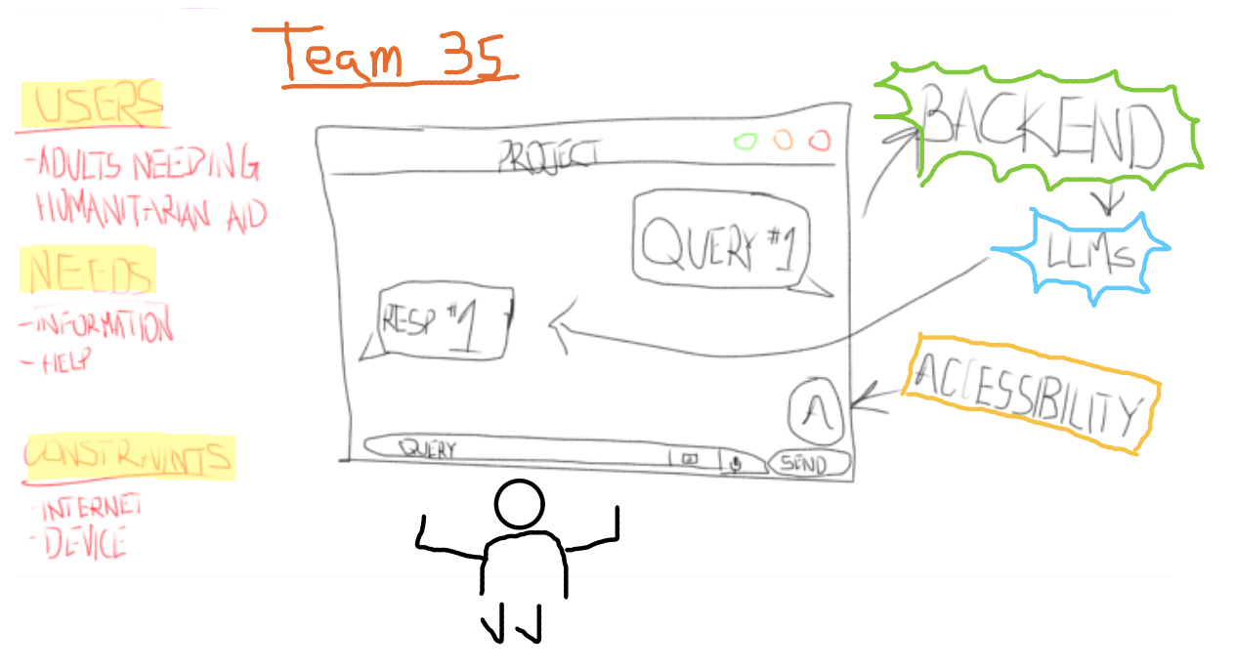
Functionality
User: enters a query in the form of text, optional image can be uploaded as well
System: returns a response in text format answering the user’s query and/or providing resources related to the query

Slide 6
Technology Considerations
Technologies
Hugging Face, Langchain, FAISS, Virtual Machine, LLMs, databases
Strengths
Open-source materials, great accessibility
Weaknesses
Paywalls, limited GPU use, biased datasets
Trade-offs
Most of the open-source materials can be modified to fit specific needs
Solutions/Alternatives
Cultivating an unbiased set of data to train our model on
Using our budget of $500 when it is absolutely necessary
Attaining a powerful enough virtual machine that can handle our workload

Slide 7
Areas of Concern and Development
The current design meets the users’ basic needs of being able to input a query and receiving a response to that query. It also satisfies the requirements of accuracy, sensitivity, and accessible interface.
Primary Concerns
Accuracy and reliability of the responses
User interface and accessibility
Data privacy and security
Compliance with HIPAA

Slide 8
Conclusions
Our detail design focus on a straight forward chatbot-like design where users input text or image queries, then responds by displaying an easy-to-read piece of text
The function design illustrates how a user would enter their queries, which the system generates text ensuring efficient and accessible interaction.
The Technology considered address user requirements for accuracy, reliability, and HIPAA compliance

